Slide 1

Basho Training Riak 301 – Search
Professional Services
August, 2015

Slide 2

Riak Search
(Codename: Yokozuna, or YZ)
Adds:
Distributed Indexing
Full Text Search
Geospatial Search
Powered by:

Slide 3
Riak Search
Enable per bucket.
Indexes inserted objects:
Unstructured Text (posts, comments, etc)
Structured Documents (JSON, XML, CSV)
Riak Data Types (CRDTs)
Headers of binary objects (Tagging)
Custom (provide an extractor)

Slide 4
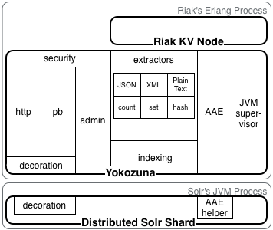
Riak Search

Slide 5
Riak Search
Powered by Solr/Lucene underneath.
Spins up a Solr instance for each node (JVM).
Erlang supervisor treats the Riak-Solr service
as a single app.

Slide 6
Using Search
Enable Search (in riak.conf)
Set up an Index (tell search which buckets to index, and how)
Insert objects
Query

Slide 7
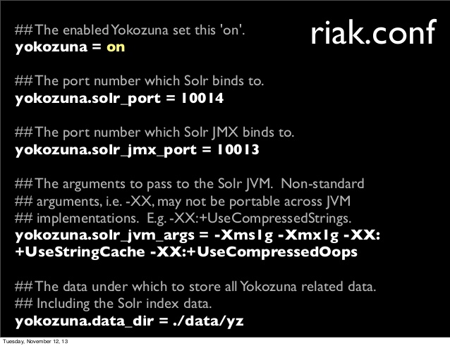
Enable Search

Slide 8
Set up Index
Define your Schema (in xml), upload to Riak
curl -XPUT http://localhost:8098/search/schema/user-profile-schema \
-H 'Content-Type:application/xml' \
--data-binary @profileSchema.xml
2. Create Index
curl -XPUT localhost:8098/search/index/user-profiles-idx -d '{"schema":"user-profile-schema"}'

Slide 9
Enable Search on Bucket Type
Create and enable a bucket type
riak-admin bucket-type create user-profiles
riak-admin bucket-type activate user-profiles
2. Tell the bucket type which index to use
curl -XPUT localhost:8098/types/user-profiles/props \ -H 'Content-Type: application/json' \
-d '{"props":{"search_index":"user-profiles-idx"}}'

Slide 10
Insert / Update Objects
Normal Riak object inserts/updates.
CRDT operations (set insert, increment counter, etc) work as expected.

Slide 11
Run Queries
Query via HTTP or client libraries.
curl ”localhost:8098/search/query/user-profiles-idx?wt=json&q=name_s:John”
{
"numFound": 1,
"start": 0,
"docs": [
{ ”admin_b": true, "age_i": 30, "name_s": ”John",
"_yz_rk": ”user1", "_yz_rt": ”sets",
"_yz_rb": ”user-profiles" } ] }

Slide 12
Caveats
Use custom schemas. (The default one indexes & stores every field).
Avoid the combination of Deep Paging and sorted results. (If you’re going to page, don’t sort).
Avoid excessive joins. Combine indexes, try to join & filter on the client side.

